Slide 1
Intellectual Property Rights

Slide 2
Kinds of Property
Movable Property
Car, Pen, Furniture, Dress
Immovable Property
Land, Building
Intellectual Property
Literary works, inventions

Slide 3
Intellectual Property Rights
Intellectual property is a property that arises from human intellect. It is product of human creation.
Intellectual Property – refers to creations of the mind, such as inventions; literary and artistic works; designs; and symbols, names and images. Intellectual Property rights provide protection for creations and inventions, to enable creators and inventors to earn recognition and financial benefit from their work.
Notes:
Literary Work means,

Slide 4
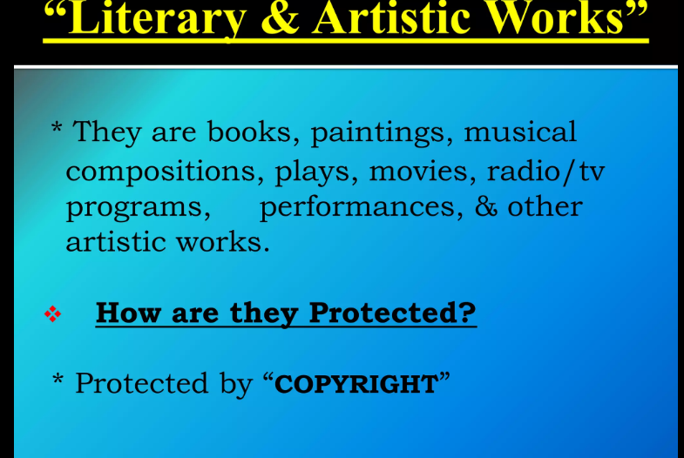

Slide 5
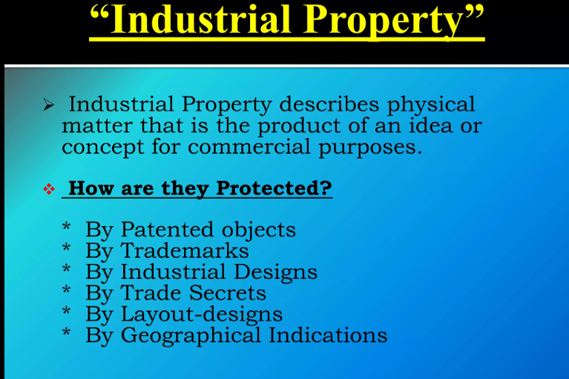

Slide 6
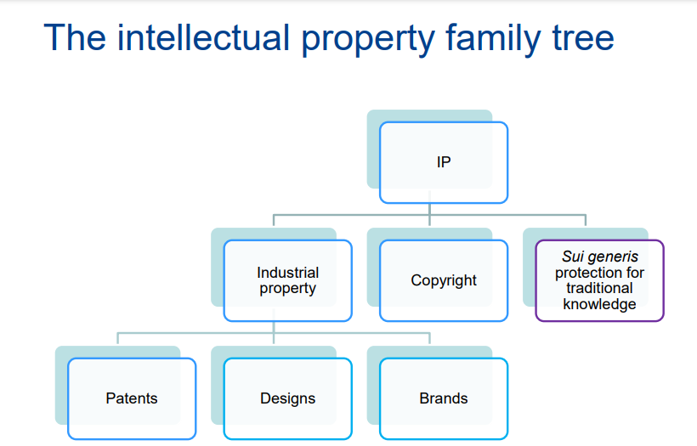

Slide 7
What is a PATENT?
A patent is an exclusive right granted for an invention, which is a product or a process that provides a new way of doing something, or offers a new technical solution to a problem
The limited monopoly right granted by the state enables an inventor to prohibit another person from manufacturing, using or selling the patented product or from using the patented process, without permission.
Period of Patents - 20 Years

Slide 8
WHAT CAN BE PATENTED?
Inventions in all fields of technology, whether products or processes, if they meet the criteria of
Novelty;
Non-obviousness (inventive step);
Industrial application (utility).

Slide 9
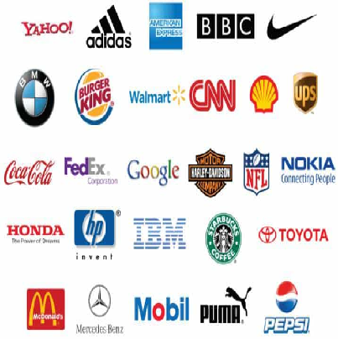
Trademark
A trademark is: A sign Capable of being represented graphically Which is capable of distinguishing goods or services of one undertaking from those of other undertakings.
The proprietor of a registered trademark has exclusive rights in the trademark which are infringed by use of the trademark in the given territory without his consent.

Slide 10
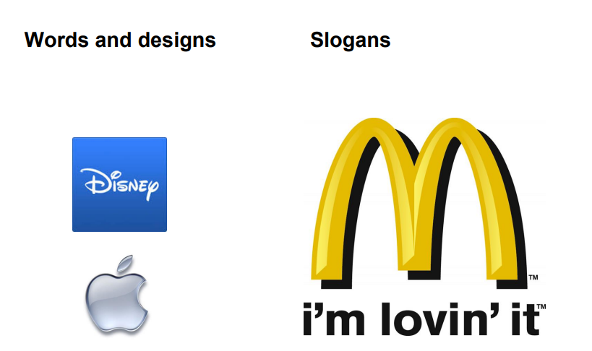

Slide 11
Registration of Trade Mark
Trade Marks are registered by national trade mark registries and are valid in that country
Registration is made after examination and publication
Period of registration is for 10 years but can be renewed indefinitely

Slide 12



WELLKNOWN MARKS
Coca Cola for soft drink
Toblerone (Triangular-
shaped chocolates)
Trade Names
Godrej- Furniture, Refrigerators, Storewell, Compactor etc
GE- Bulbs

